Slide 1





EUROPEAN YEAR OOFF SSKKIILLLLSS
Photo © Gettyimages

Slide 2


Today's presentation
2
Photo ©
Gettyimages
European Year of Skills: context and objectives
EU Skills policy
The Year in Action Stakeholder engagement

Slide 3













1. EUROPEAN YEAR OF SKILLS: CONTEXT
AND OBJECTIVES

Slide 4



Skills shortages as a challenge and skilled workforce as an enabler
EUROPEAN YEAR OF SKILLS: CONTEXT AND OBJECTIVES
4
38
occupations were classified as shortages in 2022
74% of SMEs reported
that they face skills
shortages in 2023
adult learning remains low - with a participation rate of around 37%
over 90% of jobs require digital skills; however, 54% of the adult population
in Europe has
basic digital skills

Slide 5


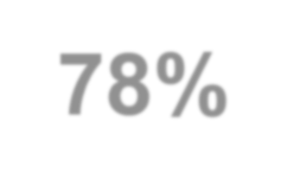
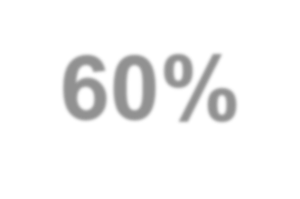





EUROPEAN YEAR OF SKILLS: CONTEXT AND OBJECTIVES
5
European Pillar of Social Rights
2030)
At least:
(2021
78%of the population aged 20 to 64 should be in employment by 2030
Current level: 73.1% (2019)
60% of all adults should participate in training every year by 2030
Current level: 37.4% (2016)
Reduce by 15 million
the number of people at risk of poverty or social exclusion by 2030
Current level: 91 million persons (2019)
Photo © Gettyimages

Slide 6
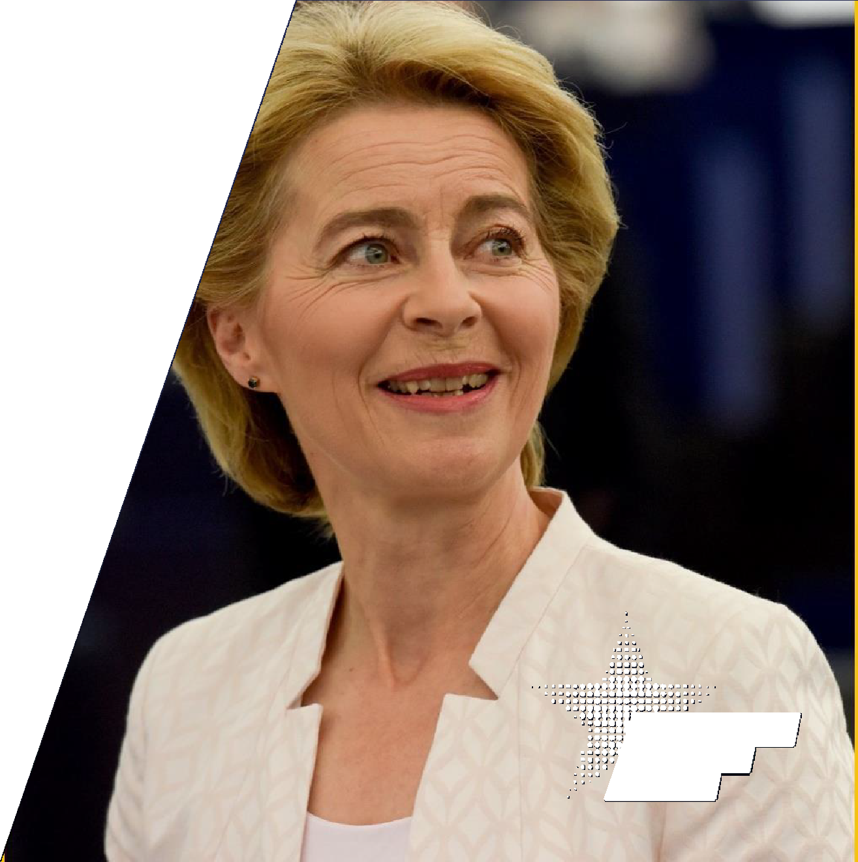

EUROPEAN YEAR OF SKILLS: CONTEXT AND OBJECTIVES
6
European companies are grappling with a shortage of staff […] Both low-end and high-end. We need everyone on board.
We need much more focus in our investment on
professional education and upskilling.
We need better cooperation with the companies, because they know best what they need.
And we need to match these needs with people’s
aspirations.
But we also have to attract the right skills to our continent, skills that help companies and strengthen Europe’s growth [...] we need to speed up and facilitate the recognition of qualifications also of third country nationals [...]
This is why I am proposing
to make 2023
the European Year of Skills

Slide 7




Why a European Year of Skills?
EUROPEAN YEAR OF SKILLS: CONTEXT AND OBJECTIVES
7
To further promote a mindset of reskilling and upskilling
Investment
Increased, more effective and inclusive investment
Skills relevance Strengthening skills relevance by close cooperation
Matching aspirations
Matching people’s aspirations and skills-set with labour market opportunities
Attracting third country talent
Attracting people from third countries with
the skills needed

Slide 8


Who is involved in the Year?
EUROPEAN YEAR OF SKILLS: CONTEXT AND OBJECTIVES
8
European Institutions
Member States
Strong involvement of Member States.
Appointment of national coordinators to raise
awareness, shape the Year, coordinate actions.
Close cooperation with the Presidencies.
Implementing bodies such as ESF+ managing authorities
European Parliament
European Commission: DG EMPL and other DGs: initiatives, support with communication and engagement
EU agencies, such as CEDEFOP, ETF, ELA
Commission Representations and EP Information Offices
CoR, EESC, EIB...
Existing platforms and networks
Engaging a wide range of stakeholders
Social partners
Civil society
Companies, chambers of commerce and industry, education and training providers, individuals
International Actors
OECD, UNESCO, ILO
Cooperation with third countries, in particular partner countries

Slide 9
2. EU SKILLS POLICY

Slide 10
European Skills Agenda
EU SKILLS POLICY
10
Tools for lifelong learning
Individual learning accounts
Micro-credentials
Europass
Strengthening skills intelligence
National Skills Strategies & Public Employment Services
Skilling for a job
Recommendation on VET
European Universities
Skills to support twin transitions
STEM graduates, Entrepreneurial & transversal skills
Skills for Life
Framework to unlock Member States’ and private investments in skills
Unlocking investment
A Pact for Skills
Joining
forces
including Blueprints

Slide 11





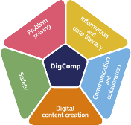



EU Tools to support skills policy
EU SKILLS POLICY
11
Europass
ESCO
European Qualifications Framework
SkillsOvate
Eures
DigComp
Photo © Gettyimages

Slide 12





EU Networks and mutual learning
EU SKILLS POLICY
12
European Alliance for
Apprenticeships
Digital Skills & Jobs Platform
Pact for Skills
EPALE
Working Group on VET & adult learning
Network of National Coordinators for adult learning
Photo © Gettyimages

Slide 13






Funding instruments to support skills policy
EU SKILLS POLICY
13
European Social Fund
Recovery and
Resilience Facility
Digital Europe Programme
Erasmus + InvestEU
Photo © Gettyimages

Slide 14













3. THE EUROPEAN YEAR OF SKILLS IN ACTION

Slide 15



The European Year of Skills lasts until May!
WHERE WE ARE
16
The Decision on the European Year of Skills was adopted on 11 May.
The Year will take place in the period of 9 May 2023 to 8 May 2024.

Slide 16

Initiatives
WHERE WE ARE
16
Work on the 2020 Skills Agenda actions:
Individual Learning Accounts, Pact for Skills, European Alliance for Apprenticeships, Centers of Vocational Excellence and others
Q1
Q2
Q3
Q1
2023
Q4
2024
Green Deal Industrial Plan
Proposal for a Council Recommendation on the enabling
factors for successful digital education
Eurobarometer on skills shortages, recruitment, and retention strategies in SMEs
Reinforced Quality Framework for
Traineeships
Proposal for a
Net-Zero Industry Act
Communication on maximising
the potential of talent mobility
Proposal for a Council Recommendation on improving the
provision of digital skills in education and training
Launch of the pilot for
the European Digital
Skills Certificate
Commission Communication on “Harnessing talent in regions”
Proposal for
a Council Recommendation
on a learning mobility framework
EU Talent Pool legislation
Launch of the Cybersecurity Skills Academy
A Commission Recommendation
on recognition of third country nationals' qualifications

Slide 17

Skills Agenda: highlights I
WHERE WE ARE
17
Pact for Skills:
Over 1,500 members, 18 large-scale partnerships
Commitment to provide over 10 million upskilling and reskilling opportunities
160 million euro investment
2 million people benefited from up- and reskilling in 2022
15 thousand training programmes developed
or updated
Individual Learning Accounts:
Around half of Member States are working on schemes of Individual Learning Accounts, in most cases supported by the ESF+ and RRF.
A Mutual Learning Programme with 7 countries (BG, FR, HR, HU*, IT, PL, RO) launched in 2023, to be expanded with further countries in 2024.

Slide 18

Skills Agenda: highlights II
WHERE WE ARE
18
European Alliance for Apprenticeships (EAfA):
10th anniversary of the Alliance with almost 400 members and more than 1 million apprenticeship places offered
Centres of Vocational Excellence (CoVEs)
400 million euros to fund 100 CoVE projects lasting 4 years in the period 2021-2027.

Slide 19
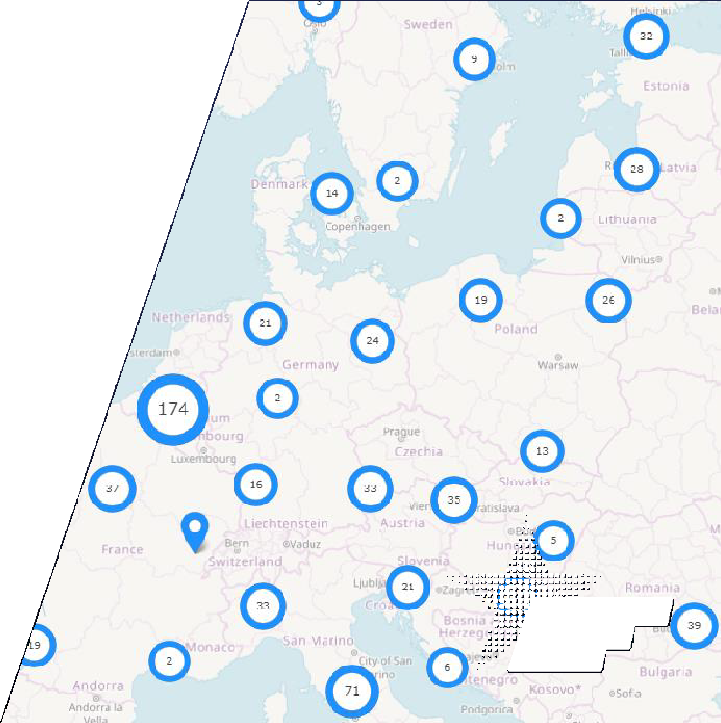
Skills in the spotlight: EU events
WHERE WE ARE
19
9 May:
The European Year of Skills Festival - 6700+ people
8 - 9 June:
Making Skills Count - 1200+ people attended
Skills in the spotlight: local events
Over 1200 planned so far – 800+ already implemented
Spread across 38 countries. Most events in Belgium, Italy, Spain, Germany and France
Around 70% of the events address
more than one of the specific objectives
the Year. Investment in skills and
skills relevance are addressed the most.
of

Slide 20
4. STAKEHOLDER ENGAGEMENT

Slide 21
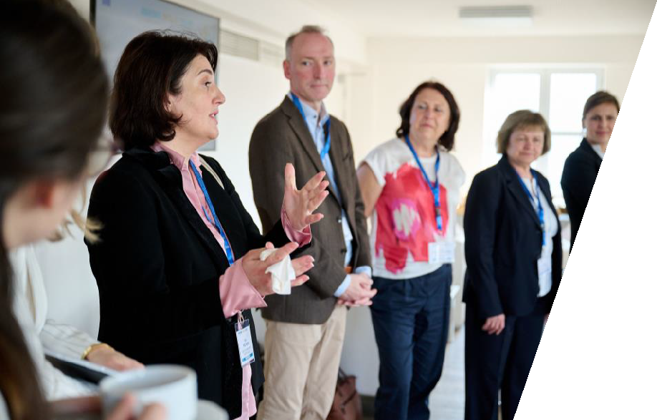
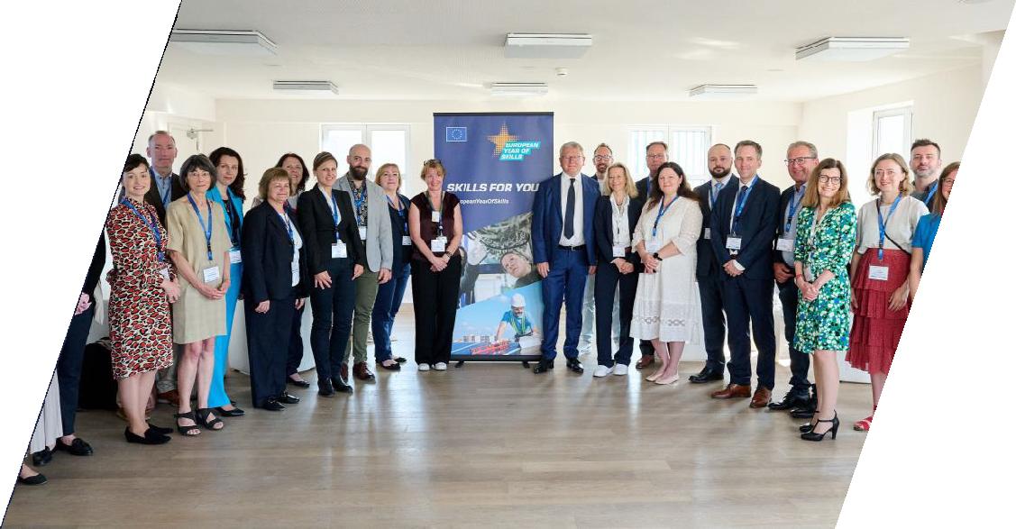
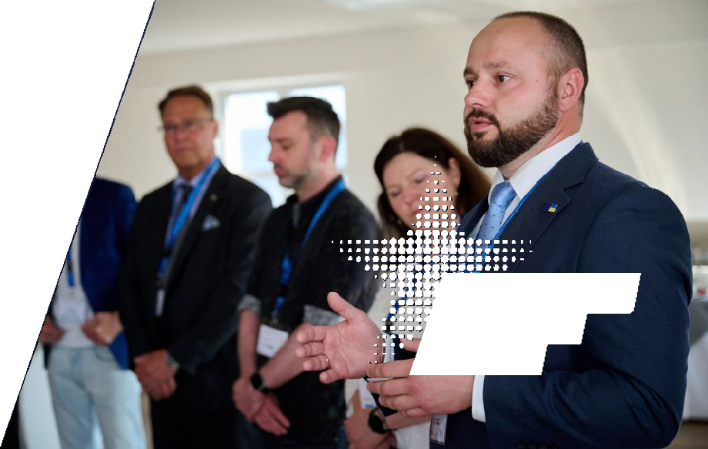

Engaging key stakeholders: National Coordinators
NATIONAL COORDINATION
39 countries have appointed their national coordinator(s), including all Member States. Full list available here;
National Coordinators meet throughout the Year to exchange on national activities and learn from each other. Being the bridge between the EU and national level, they drive and shape the Year at national, regional and local level.
Exchanges reveal elaborate national plans:
focusing on implementing EU initiatives (e.g.: Individual Learning Accounts);
fostering training and adult learning in line with the needs of the labour market;
setting up new projects to give visibility to skills and to promote a mindset of up and reskilling.

Slide 22

The impact of the EYS at the local level
2. THE EYS IN ACTION: ON THE GROUND
Promote implementation of existing initiatives that have a local impact: in particular CoVEs and Pact for Skills, but also ILA, Microcredentials etc.
Local stakeholder engagement through
National Coordinators, and
direct involvement in conferences and key skills fora; access to funding, share of good practices, etc., etc.
Visibility of local initiatives and stories: website, events map, social media campaigns (influencer), media Partnerships (ex. People of Sofia)

Slide 23

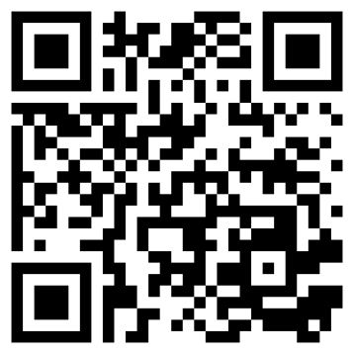
EYS website
EYS WEBSITE AND LOCAL EVENTS
23
In my country
On the ground: success stories on upskilling and reskilling. Share yours too!
Events. Add yours too!
News
Coming soon: Experts' corner.
Get inspired, get involved, get skilled!

Slide 24
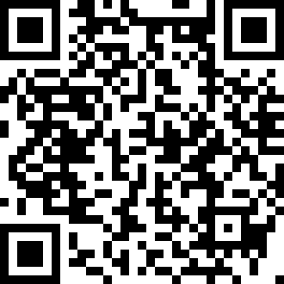




Thank you for your interest!
24
We look forward to collaborating with you to make the European Year of Skills a success!
Useful link: European Year of Skills webpage
#EuropeanYearOfSkills

